Slide 1
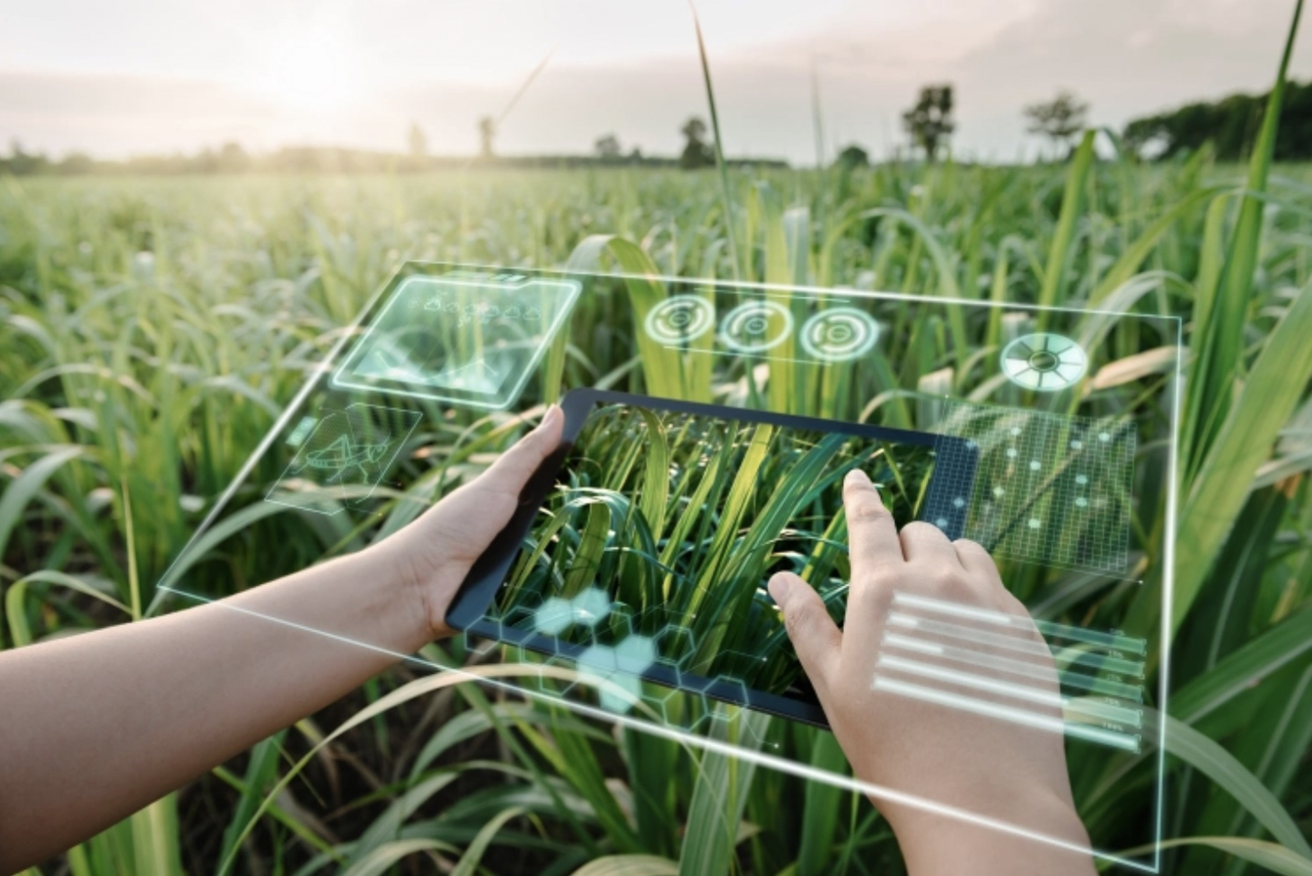
FARMER AI

Slide 2
TABLE OF CONTENTS
INTRODUCTION
PROBLEM STATEMENT
DATA COLLECTION
DATA PREPROCESSING
COMPONENTS OF FARMER AI
MACHINE LEARNING MODEL
MODEL TRAINING AND VALIDATION
RESULTS
CONCLUSION

Slide 3
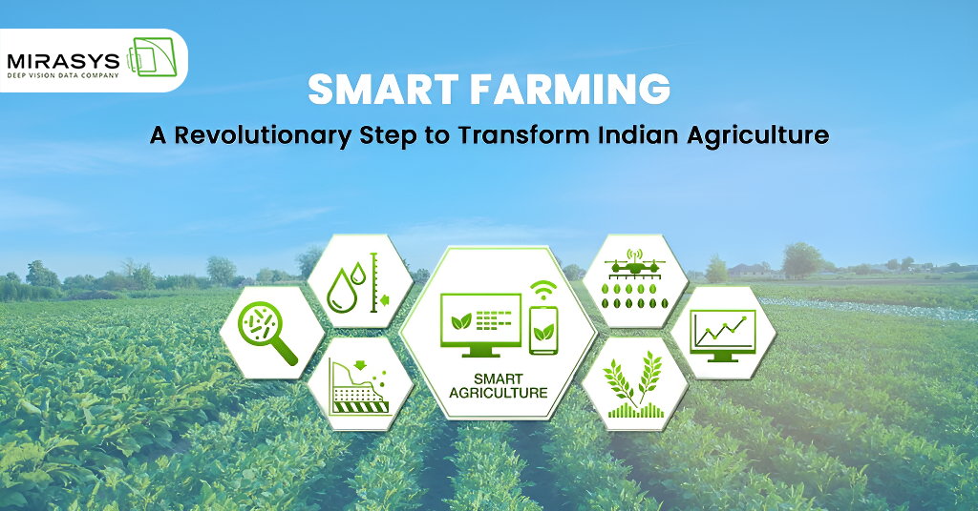
INTRODUCTION
These AI systems utilized early machine learning techniques and data analysis methods to address pressing agricultural and environmental challenges.
In water level estimation, they processed data from sensors and satellite imagery to monitor water bodies and predict water availability.
For climate change estimation, former AI analyzed historical data and climate models to assess trends and potential impacts. Additionally, in agriculture, they calculated crop water requirements based on factors like soil moisture and weather conditions, aiding in efficient irrigation management. Furthermore, former AI systems employed image recognition and pattern recognition algorithms to detect pests and diseases in crops, enabling early intervention and improved crop health. While these technologies have been superseded by more advanced AI models, they laid the foundation for modern solutions addressing similar challenges.

Slide 4
PROBLEM STATEMENT
Modern agriculture faces numerous challenges that impede productivity and sustainability. These issues include unpredictable weather patterns, inefficient pest and disease management, poor soil health monitoring, water scarcity, and inaccurate yield prediction.
DETAILED PROBLEM DESCRIPTION:
Unpredictable weather patterns
Pest and Disease Management
Soil and Health Monitoring
Water Resource Management
Accurate Yield Prediction

Slide 5
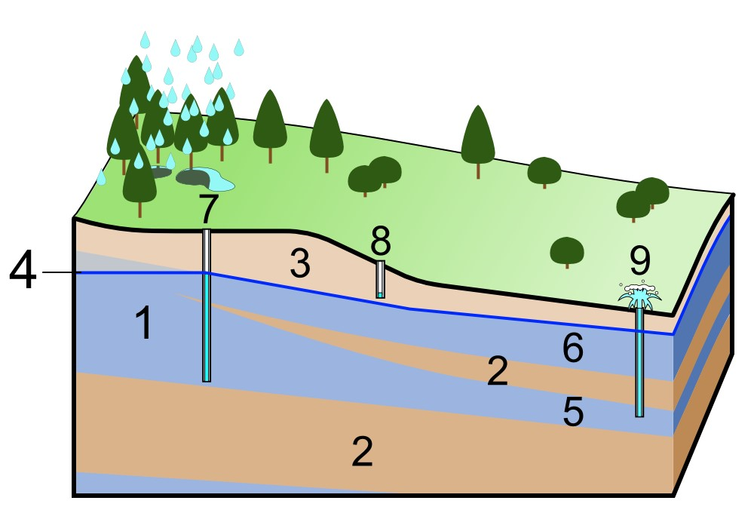
DETECTS WATER LEVEL
Farmer AI is an innovative tool designed to provide crucial information about the underground water levels in agricultural lands.
By utilizing advanced sensors and data analysis, Farmer AI can accurately measure and monitor the water table beneath the soil.
This information is invaluable for farmers, as it allows them to make informed decisions about irrigation and crop management, ensuring optimal water usage and preventing over-extraction.
With real-time updates and predictive analytics, Farmer AI helps farmers maintain the health of their soil and crops, leading to more sustainable and productive farming practices.
This technology not only aids in water conservation but also enhances the overall efficiency and profitability of agricultural operations.

Slide 6
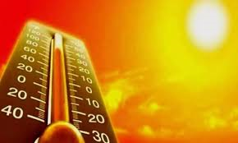
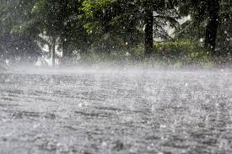
ESTIMATING CLIMATE CHANGES
Utilizing AI to detect weather patterns based on previous data can be a game-changer for farmers, significantly enhancing their decision-making processes and crop management strategies. Farmer AI employs advanced machine learning algorithms to analyze vast amounts of historical weather data, including temperature, humidity, precipitation, and wind speed. By identifying patterns and anomalies, the AI can predict future weather conditions with remarkable accuracy. This predictive capability enables farmers to optimize planting schedules, irrigation practices, and harvest times, thus maximizing yield and minimizing waste.

Slide 7
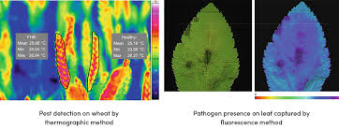
DETECTING PEST AND DISEASES
Predicting pests and diseases in crops using artificial intelligence (AI) has revolutionized modern agriculture. By harnessing the power of machine learning algorithms and big data analytics, AI systems can analyze vast amounts of historical data, including weather patterns, soil conditions, crop health records, and pest behaviors. These systems can then identify patterns and correlations that may not be apparent to human observers. For instance, AI can predict the likelihood of a pest outbreak or disease spread based on changes in temperature and humidity or the presence of certain plant stress signals. This proactive approach allows farmers to implement targeted interventions, such as timely pesticide applications or crop rotations, thereby minimizing crop damage and maximizing yield. The integration of AI in agriculture not only enhances efficiency but also promotes sustainable farming practices by reducing the overuse of chemicals and preserving the environment.

Slide 8
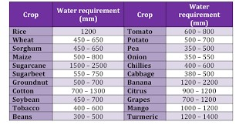
WATER REQUIREMENT BASED ON CROPS
Using advanced AI technology, farmers can now receive precise recommendations on the optimal amount of water required for their crops. This AI-driven advice is based on a comprehensive analysis of historical data, including weather patterns, soil moisture levels, crop type, and growth stages. By integrating data from various sources such as satellite imagery, IoT sensors, and local meteorological reports, the AI can tailor irrigation schedules to ensure crops receive the exact amount of water they need, reducing waste and enhancing yield. This precision agriculture approach not only conserves water resources but also promotes sustainable farming practices, ensuring food security and environmental stewardship.

Slide 9
COMPONENTS OF FARMER AI
KEY TECHNOLOGIES:
Climate change: Increasing unpredictability in weather patterns affecting crop yields.
Pest and disease management: Difficulty in timely and accurate detection leading to crop losses.
Soil health and fertility: Maintaining soil quality to ensure sustainable farming.
Water management: Efficient use of water resources for irrigation.
Yield prediction: Accurately predicting crop yields to plan and manage supply chains.

Slide 10
MACHINE LEARNING MODELS
Convolutional Neural Networks (CNNs)
Random Forests
Support Vector Machines
K-Means Clustering
Long Short-Term Memory Networks (LSTMs)

Slide 11
MODEL TRAINING AND VALIDATION
1.Convolutional Neural Networks (CNNs):
Used for image recognition tasks such as detecting pests and diseases in crops. CNNs analyze images captured by drones or smartphones to identify signs of pest infestations or disease symptoms, allowing for early intervention and management.
Detecting leaf spots, blight, or insect damage on crops.
2.Random Forests:
Employed to predict crop yields based on historical yield data, soil quality, weather conditions, and other environmental factors. This model aggregates the predictions from multiple decision trees to improve accuracy and robustness.
Estimating the expected yield of wheat or maize based on seasonal data
3.Support Vector Machines (SVMs):
Effective for classifying different types of plant diseases and distinguishing between various crop species based on feature data. SVMs can handle high-dimensional data and provide reliable classification results.

Slide 12
Identifying whether a plant is infected by a specific pathogen or not based on leaf characteristics.
4. K-Means Clustering:
Utilized for segmenting farmland into distinct management zones based on soil health, moisture levels, and crop conditions. This helps in applying targeted treatments and optimizing resource use.
Dividing a large farm into zones that require different amounts of fertilizer or irrigation.
5.Long Short-Term Memory Networks (LSTMs):
Analyzing time-series data for weather forecasting, predicting crop growth stages, and monitoring changes over time. LSTMs are capable of capturing long-term dependencies and trends in sequential data.
Forecasting the next season's weather patterns and their potential impact on crop growth.

Slide 13
FEATURES
Farmer can sell their crops in the FARMER AI
User will directly buy the crops from farmer
FARMER AI also contains online shopping
Based on market crop demand it suggests a crop name to farmer

Slide 14
WHY AI?
Efficiency Improvements
Cost Reduction
Precision Farming
Data-driven Decision Making
Increased Productivity
Early Detection Of Issues
Sustainability

Slide 15
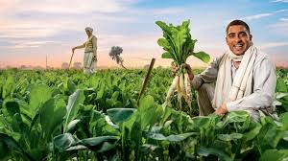
CONCLUSION
Given the complexity of factors such as water level, climate changes, crop pests and diseases, and crop demand, FARMER AI might suggest a
crop like drought-resistant maize for the farmer.
Drought-resistant maize varieties are specifically bred to thrive in conditions with limited water availability, making them ideal for regions facing water scarcity due to climate change.
Additionally, advancements in genetic modification and breeding techniques have made these crops more resilient against common pests and diseases.
With maize being a staple food in many parts of the world, the demand typically remains high, providing a reliable market for the farmer.
This recommendation aims to balance environmental sustainability with economic viability, ensuring the farmer can achieve a successful harvest despite the challenging conditions.

Slide 16
ANY QUERIES?

Slide 17
THANK YOU

